Slide 1
10 Park Terrace Application to Maintain Trees
Houses (9 & 10)
Tree 2
Beech Tree

Slide 2
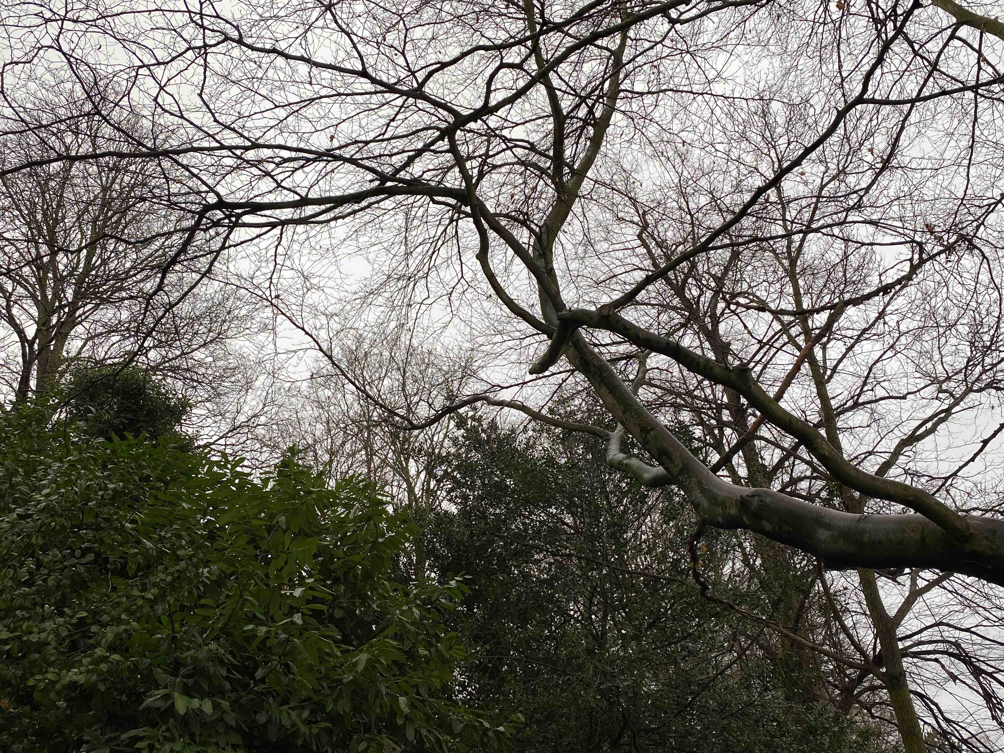
Beech Tree
1) Remove these two branches as they now interfere with the laurel bush below it. The positions to cut are shown with yellow circles
2) Crown lift to 4M from ground (road) level

Slide 3
Tree 2
Crown lift to 4M height from level of garden, i.e. base of tree as they are now encroaching on nearby trees and reducing light into garden

